Slide 1
Applied Informatics for IT Companies new Bachelor study in SEEU in Tetovo Integrated (Dual Study) Programme
Betim Çiço b.cico@seeu.edu.mk
Norbert M. Marx dat-org_marx@t-online.de
13th Workshop on SEERE, Bansko – 28.08.2013
www.seeu.edu.mk

Slide 2
South East European University
Founded in 2001 as a private, public, not for profit higher education institution
Sponsored by the EU Commission and USAID, among other.
SEEU is now in its eleven year of operation with more than 7000 students and 3000 graduates.
A model for multi-ethnic, multi-lingual higher education in South East Europe.
Lectures offered in Albanian, Macedonian and English.
www.seeu.edu.mk

Slide 3
South East European University
Faculty of Languages, Cultures and Communication,
Faculty of Law,
Faculty of Public Administration and Political Science
Faculty of Business and Economics.
Faculty of Contemporary Sciences and Technologies,
Staff: 5 full professors, 2 associate professors, 14 assistant professors, 5 assistants (PhD candidates)

Slide 4
Faculty of Contemporary Sciences and Technologies,
Undergraduate study programs - ongoing
Computer Sciences
Media Informatics
Business Informatics
Computer Engineering

Slide 5
Faculty of Contemporary Sciences and Technologies,
Graduate study programs - ongoing
Media Informatics (120 ЕCTS)
Software Engineering (120 ЕCTS)
Database Management (120 ЕCTS)
Software and Application Development (60 ЕCTS)
Business Informatics (120 ЕCTS)

Slide 6
Faculty of Contemporary Sciences and Technologies,
New postgraduate study programs
Master
Software Engineering and Telecommunication
Application of Information and Communication Technologies (ICT) in Teaching
Cloud Computing and Mobile Web Applications
Doctoral Studies
E-Technologies
Environmental Management

Slide 7
Faculty of Contemporary Sciences and Technologies,
New undergraduate study programs
Contemporary Banking Management
Applied Informatics for IT companies
Contemporary Enterprise Management
http://www.seeu.edu.mk/en/integrated-studies

Slide 8
Dual Study Program at the South East European University
Employment market in the region today has a growing demand for well-skilled staff, trained in close connection with practice.
Based on this demand, the South East European University will begin in September 2013 a Dual Study Program, identical to the well-known “Dual Universities/Universities of Applied Sciences“, Germany.

Slide 9
Dual Study Programs at the South East European University Tetevo
The essential characteristic of this Dual Study Program is the combination of specific scientific knowledge and practical internships:
SEEU provides the science related academic education, and
Companies/Banks provide the work related training-on-the-job.

Slide 10
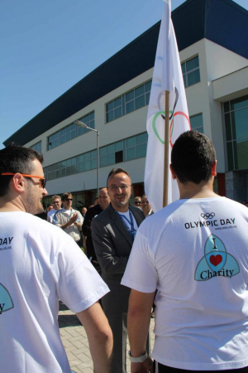
What the South East European University offers
Three-Years-Study Program with 180 Credits(ECTS) in:
Contemporary Banking Management
Applied Informatics for IT companies
Contemporary Enterprise Management

Slide 11
What the South East European University Tetevo offers
After the Three-Years Study Program the students will be awarded with the University Diploma
“Bachelor”.
Students receive during the study practical experience: A very good basis to start their professional carrier.

Slide 12
Structure of the Dual Study Programmes
General
University
entrance
Exam
Final
exams
Approval
(selected
by partner
companies)
Job
Practice

Slide 13
Professors and experienced Lecturer from SEEU and various international Universities/Countries

Slide 14
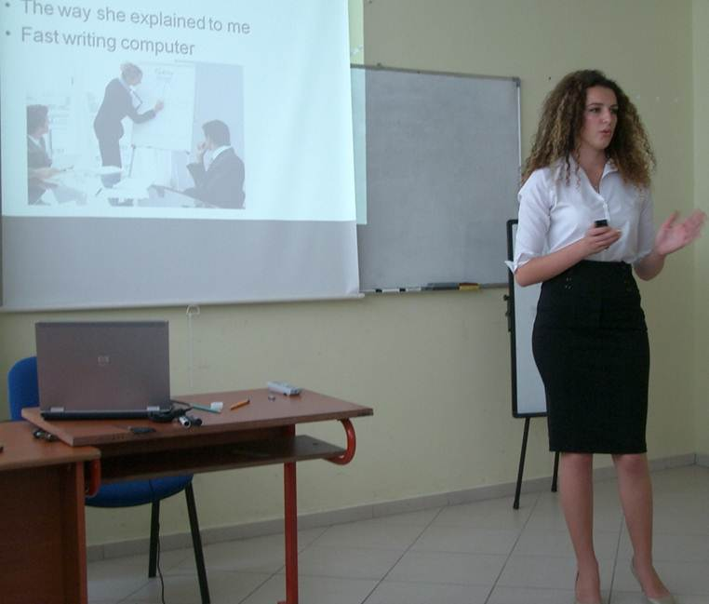
Study methods
Teaching sequences;
Case Studies;
Communication;
Discussions;
Group work;
Presentations;
Management Games;
Simulations,
Work on Texts; etc.

Slide 15
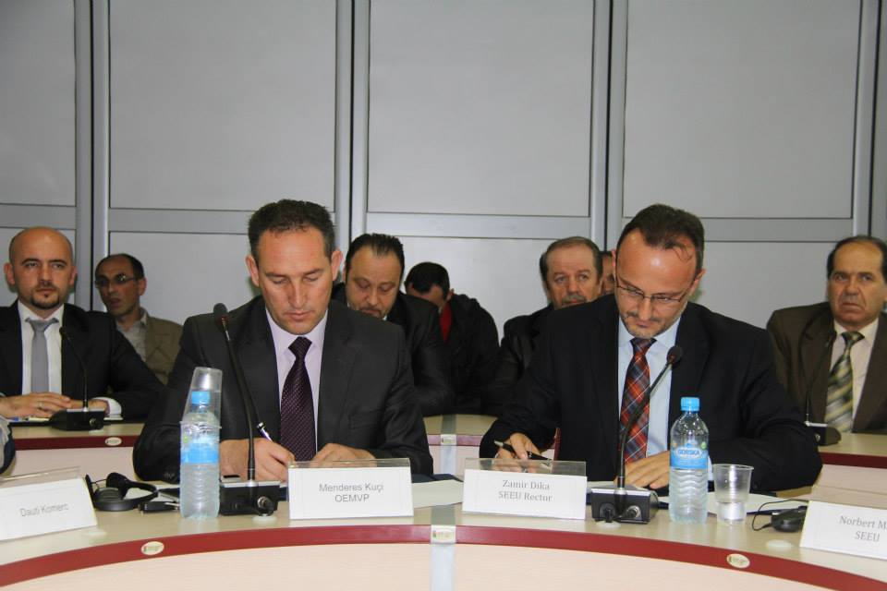
Students are chosen by Partner Companies/Banks in Cooperation with the SEEU Tetevo
Students need to have the general qualification for University entrance according to Macedonian Laws;
A training contract with internship in a Company or Bank;
Very good English knowledge.

Slide 16
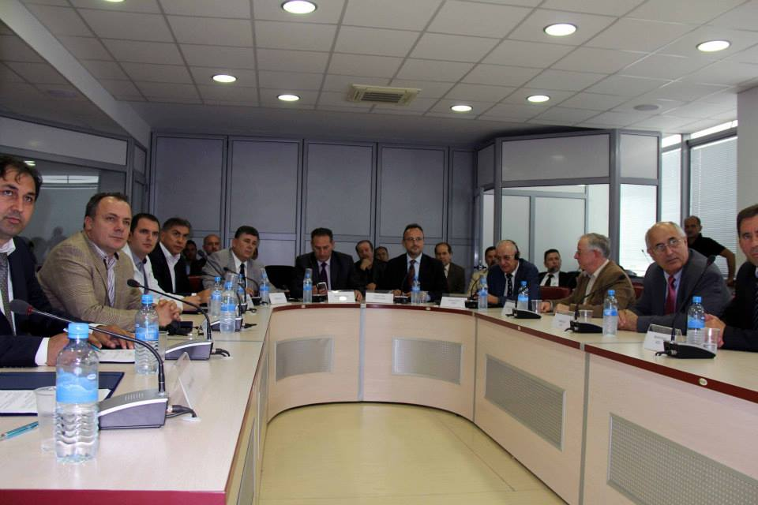
Partners of the South East European University

Slide 17
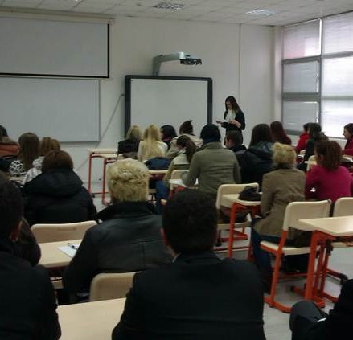
Studying at SEEU
Students learn in small classes;
Adapted curricula according to the Macedonian Labour Market needs;
Academic studies and practical training are closely integrated;
Lectures by international Guest Professors and experts from SEEU, Partner Companies and Banks;
Possibilities to go further with postgraduate studies;
Graduates have outstanding career prospects on the national and international job market.

Slide 18
Curriculum: Applied Informatics for IT companies
Semester 1
Calculus (6.0 ECTS)
Computer Systems (6.0 ECTS)
Programming Concepts (6.0 ECTS)
Free elective course 1 (6.0 ECTS)
Elective Albanian / Macedonian Language I / 1 (3.0 ECTS)
Elective English Language I / 2 (3.0 ECTS)
Semester 2
Web Technologies and Architectures (6.0 ECTS)
Linear Algebra (6.0 ECTS)
Computer programming C++ (6.0 ECTS)
Free elective course 2 (6.0 ECTS)
Elective Albanian / Macedonian Language II / 3 (3.0 ECTS)
Elective English Language II / 4 (3.0 ECTS)

Slide 19
Curriculum: Applied Informatics for IT companies
Semester 3
Optimization Methods (6.0 ECTS)
Web Technologies (6.0 ECTS)
Object-Oriented Programming (6.0 ECTS)
Free elective course 3 (6.0 ECTS)
Elective English for specific purposes I / 5 (6.0 ECTS)
Semester 4
Relational databases and SQL (6.0 ECTS)
Applied Probability and Statistics (6.0 ECTS)
Operating Systems (6.0 ECTS)
Elective English for specific purposes II / 6 (6.0 ECTS)
Elective course / 7 (6.0 ECTS)

Slide 20
Curriculum: Applied Informatics for IT companies
Semester 5
Software Engineering (6.0 ECTS)
Computer Networks (6.0 ECTS)
Web Programming (6.0 ECTS)
Advanced elective course / 8 (6.0 ECTS)
Advanced elective course / 9 (6.0 ECTS)
Semester 6
Software Testing and Maintenance (6.0 ECTS)
Human-Computer Interface (6.0 ECTS)
Business Applications Development (6.0 ECTS)
Elective course / 10 (6.0 ECTS)
Elective course / 11* (Capstone Project) (6.0 ECTS)

Slide 21
Curriculum: Applied Informatics for IT companies
List of elective courses
Semester 4
E-Commerce
Fundamentals of Information Systems
Multimedia Systems
Semester 5
Data Mining
Programming Mobile Devices
Database Administration
Microcontrollers and Embedded Systems
Data Visualization
Semester 6
Java Programming
Development of web based mobile applications
Wide Range Networks
Web Development using XML

Slide 22
Experiences from similar dual study programs - FASTIP Durres Average Training Costs for the Employers per year
€

Slide 23
Experiences from similar dual study programs - FASTIP Durres Cost Overview
 | Company |  | Trainee Remuneration | Trainer Salaries | Station Cost | Training Material |  | Total Direct Cost |  | Total Indirect Cost |  | Total Cost
 | Bank A |  | 1.200 | 626 | 231 | 0 |  | 2.057 |  | 1.200 |  | 3.257
 | Bank B |  | 2.400 | 339 | 124 | 2 |  | 2.865 |  | 1.200 |  | 4.065
 | Bank C |  | 0 | 310 | 172 | 54 |  | 535 |  | 1.200 |  | 1.735
 | Total |  | 1.800 | 425 | 176 | 28 |  | 1.819 |  | 1.200 |  | 3.019

Slide 24
Experiences from similar dual study programs - FASTIP Durres Benefit Overview
Company |  | Productive Work | Opportunity Benefit |  |  |  | Total benefit
 |  |  | Projects (Market Research) | Recruitment | Induction
Bank A |  | 600 | 0 | 0 | 0 |  | 600
Bank B |  | 1.839 | 234 | 19 | 73 |  | 2.165
Bank C |  | 736 | 248 | 0 | 273 |  | 1.257
Total |  | 1.058 | 241 | 19 | 173 |  | 1.341

Slide 25
Experiences from similar dual study programs - FASTIP Durres Cost-Benefit Overview
 | Company |  | Cost |  | Benefit |  | Result
 | Bank A |  | 3.257 |  | 600 |  | -2.657
 | Bank B |  | 4.065 |  | 2.165 |  | -1.901
 | Bank C |  | 1.735 |  | 1.257 |  | -478
 | Total |  | 3.019 |  | 1.341 |  | -1.679

Slide 26
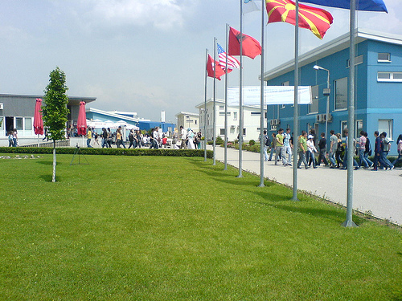
Contact Information
Ilindenska n. 335
1200 Tetovo
Republic of Macedonia
Phone +389-44-356110
Fax +389-44-356111
www.seeu.edu.mk

Slide 27
Thank you ! Questions ?

